Slide 1


Outland Adventures Case Study
A Database Project by Bravo Group CSD 310, Professor Sue Sampson
Assignment: 11.2
December 10th, 2023
Andrew Bach, Torren Davis, John Garcia III, Taylor Mommer, Ian Spresney

Slide 2
Group Introductions
This project was worked on by the collaboration of Bravo Group, which includes the following:
Andrew Bach – Database Administrator and Data Analyst responsible for managing the overall health, performance, security, and integrity of the database.
Torren Davis – Presentation administration responsible for displaying a presentation to show project result. Assists with database administration tasks and ERD management.
John Garcia III – Project leader, responsible for overseeing project progress and assigning tasks to group members. Assists with ERD management and database administration tasks.
Taylor Mommer - Database Administrator responsible for analyzing data, creating reports, and extracting insights from data stored in databases. Assists with database administration tasks and ERD management.
Ian Spresney- Database Administrator responsible for analyzing data, creating reports, and extracting insights from data stored in databases. Assists with database administration tasks and ERD management.

Slide 3
The Case Study Summary
Outland Adventures
In short, Outland Adventures, created by Blythe Timmerson and Jim Ford, was a side business that catered to outdoors fans turned full time profession. The business would provide equipment and arrange guided trips to various locations. To optimize the business, the following questions were asked:
Do enough customers buy equipment to keep equipment sales?
Are there inventory items that are over five years old?
Is there any location that has a downward trend in bookings?

Slide 4
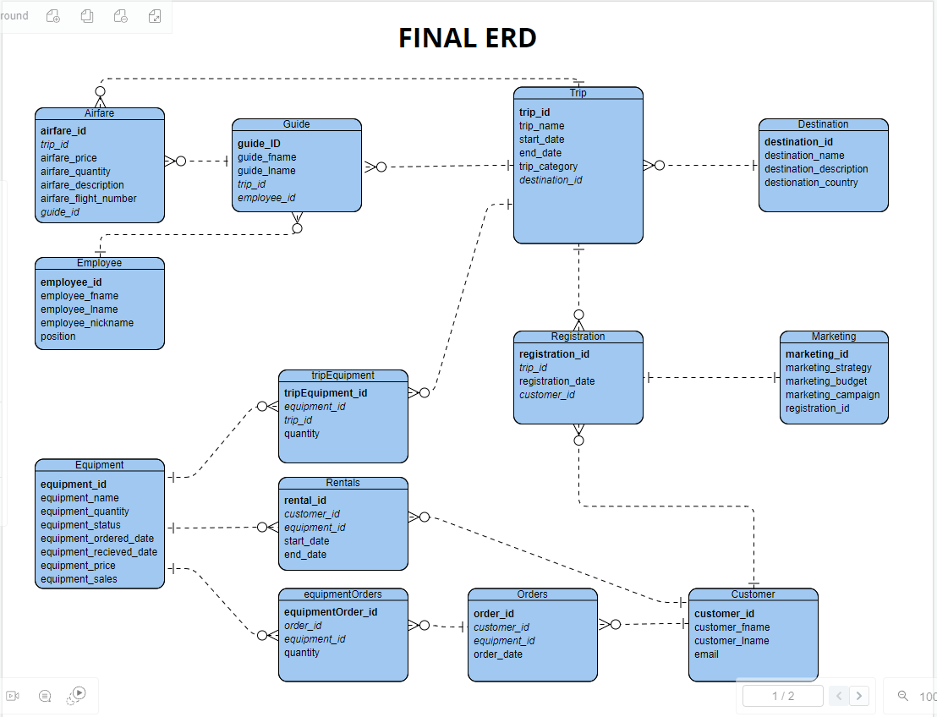
ERD

Slide 5
Report 1- Countries Report
Question: Is there any location that has a downward trend in bookings?
Solution: The solution that we, group bravo, produced was a report that would query the database and display trip information such as the trip's name, its location, the country, the number of registrations the trip has had, and the year of the trip. With this information, Outland Adventures would be able to clearly see the booking trends for each location and be more informed about whether a specific location has had a downtrend in bookings or not.

Slide 6
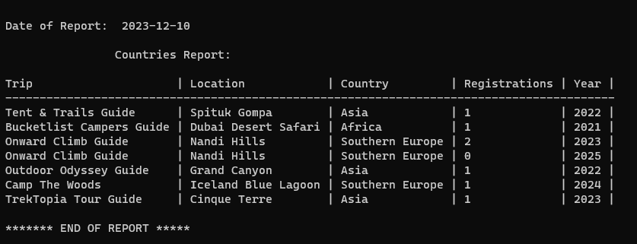
Report 1- Countries Report

Slide 7
Report 2- Sales Report
Question: Do enough customers buy equipment to keep equipment sales?
Solution: The solution that we produced was a report that would query the database and display sales information such as the product (we substituted the name equipment for product so that we can have a table filled with items that are for sale called products, and items that are not for sale called equipment) that is for sale, the price of that product, and the revenue the company has made from the sales of that product. With this information, Outland Adventures would be able to see how much money they make, in revenue, from selling products to customers and make an informed decision on whether to keep the product sales aspect of their business.

Slide 8
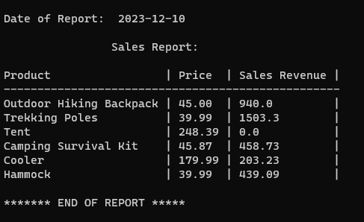
Report 2- Sales Report

Slide 9
Report 3 – Equipment Age:
Question: Are there inventory items that are over five years old?
Solution: The solution we produced was a report that would query the database and display information on equipment that is relevant to its age such as the equipment name, the day it was ordered, the day it was received, the age (in days), and if the equipment was over 5 years old. The report will be from oldest to newest so that all older equipment will be shown first. With this information, Outland Adventures would be able to clearly identify any equipment they have that is over 5 years old. They would also be able to clearly identify any equipment that is inching closer to 5 years of age since the report will show all older equipment first.

Slide 10
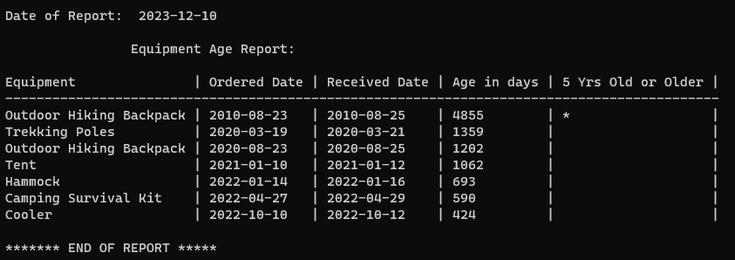
Report 3 – Equipment Age:

Slide 11
Report 4 - Registration Data:
This report is used to display the customers who have submitted registrations along with the data for each registration. Show the registration date, trip name, the marketing campaign associated with the registration, and the dates for the specified trip.
Displays which registrations are renting equipment and which are purchasing equipment.

Slide 12
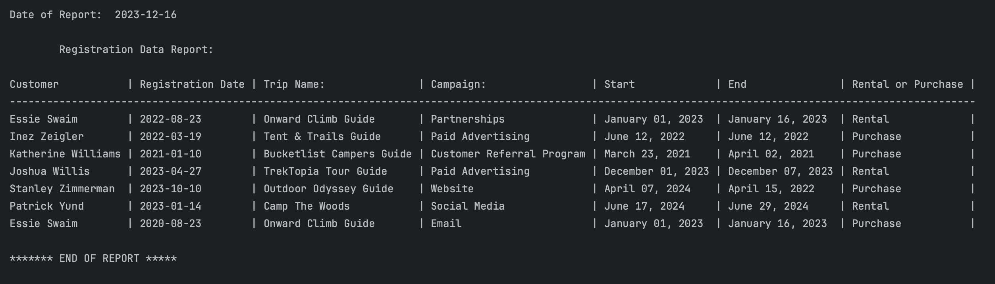
Report 4- Registration Data:

Slide 13
Assumptions Made
More than one guide can be assigned to one trip.
Customers will be able to register for a trip through the site.
Trips will have at least one guide.
Equipment can be associated with multiple trips.
Rented equipment will only be associated with the customer renting it until it is returned.

